Slide 1

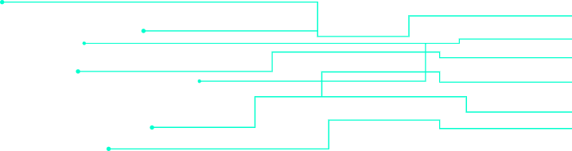
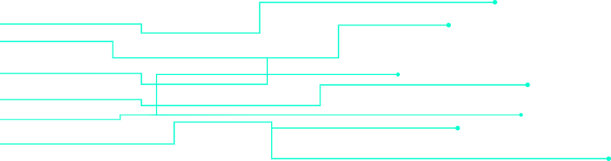

EfficientNeT DT and VANET
(Convolutional Neural Networks)
Research Talk by
Qasim Zia

Slide 2





EfficientNet, VANET, Digital Twins
Image Classification Model

Slide 3
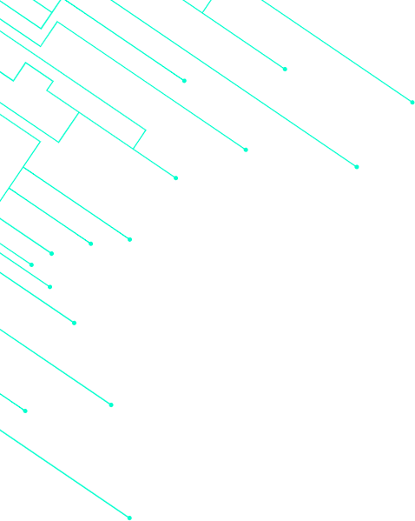



01
Introduction
CNN, ResNet, EfficientNet
02
DT-VANET
Table of Contents
03
Problem Statement
04
Solution

Slide 4
01
Introduction

Slide 5

Convolutional Neural Network, Residual Network
Depth Scaling
More Accuracy
Vanishing Gradient
Residual Neural Network “skip connection”

Slide 6
Still Issues?
Lots of Processing (Layers)
Lots of Computation (Training)
Time-Consuming Processing

Slide 7



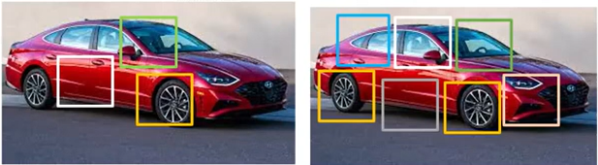
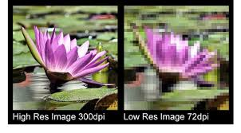
The Magic of EfficientNet
A Research
Depth(Layers)
Width
Channels
Resolution
Balance all network dimensions network width, depth, and resolution

Slide 8
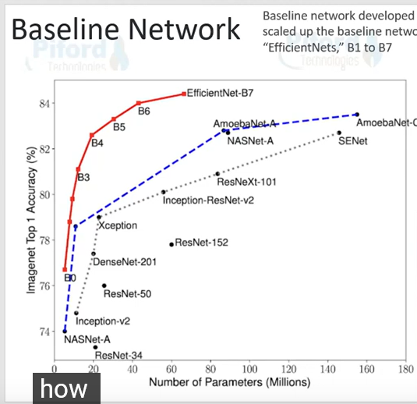
Compound Scaling
Baseline Model: EfficientNet B0
To Scale the depth, width, and resolution, a baseline model is needed which is, here, called “Efficientnet B0”
And scale for each Efficientnet
Efficientnet-B0(NAS) Efficientnet-B1
Efficientnet-B2
Efficientnet-B3
Efficientnet-B4
Efficientnet-B5
Efficientnet-B6
Efficientnet-B7

Slide 9
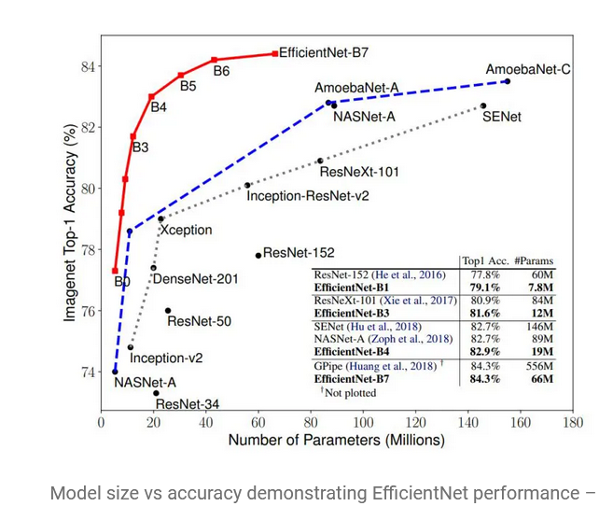

Slide 10
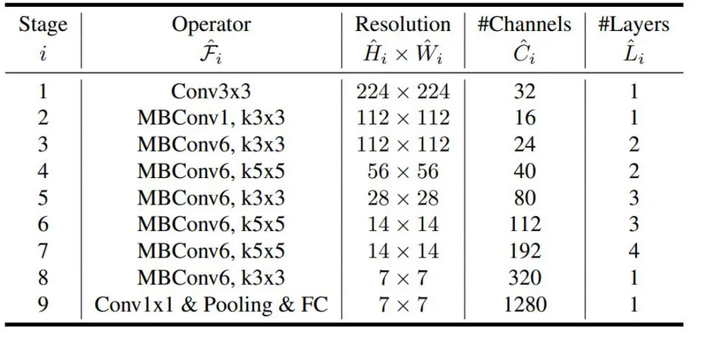

Slide 11
02
DT-VANET

Slide 12
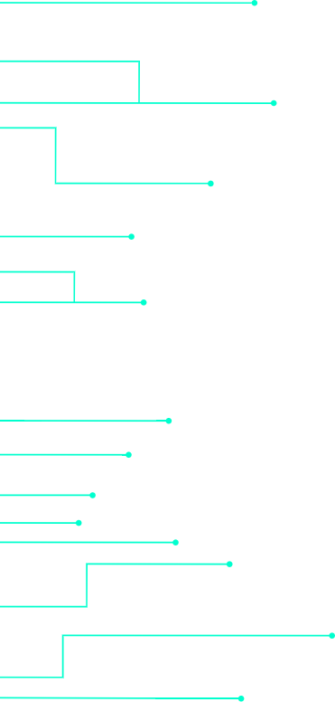
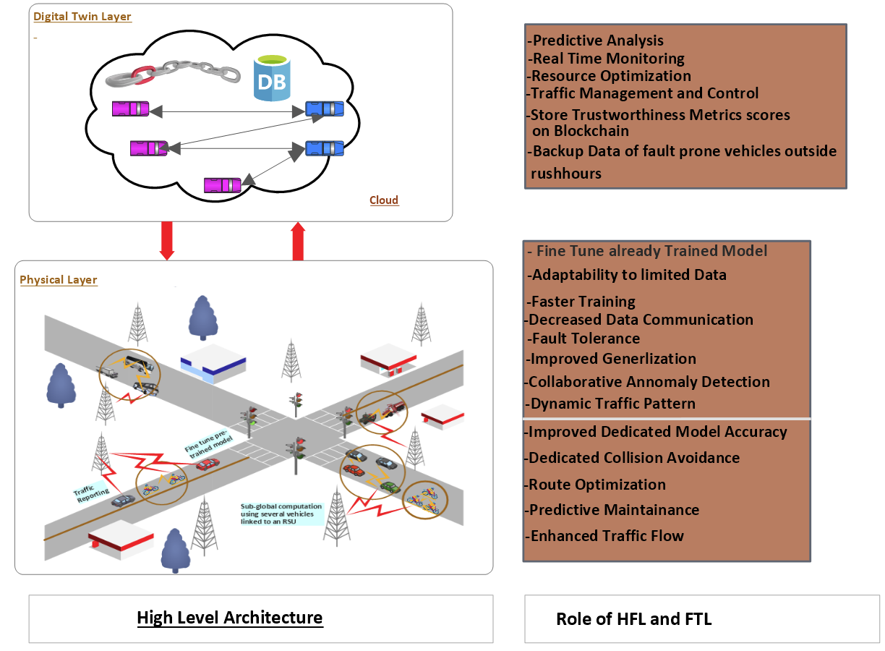
DT-VANET Current Architecture

Slide 13
03
Problem Statement

Slide 14

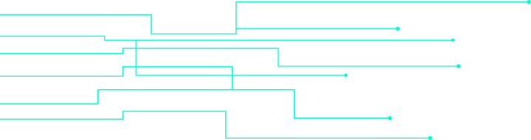



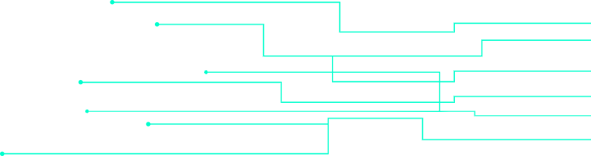
Data Latency and Volume
The Rapid Generation of Data from different sources.
Computational Complexity
Complex Models and Computations
Model Efficiency
Traditional deep-learning models are powerful but not good real-time applications
Decision Quality
Decisions are optimized for minimizing accidents

Slide 15
04
Solution

Slide 16

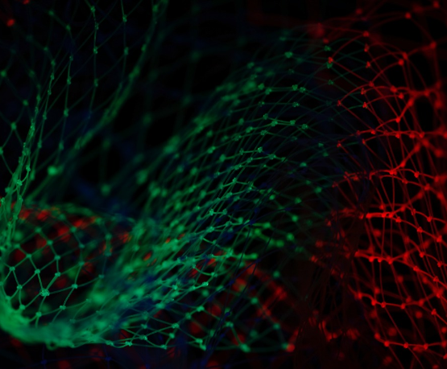
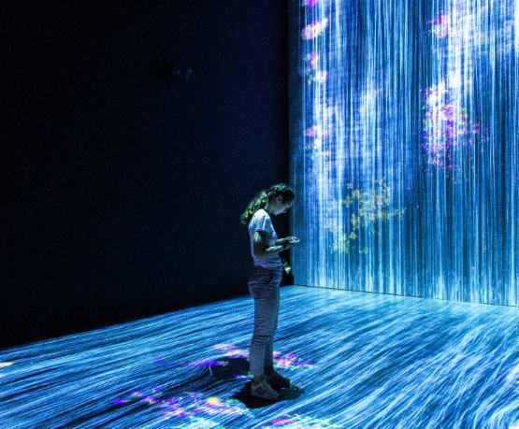
Model and Decision Efficiency
EfficientNet increases efficiency by Fewer Parameters, Low Computational Cost, Scalability and Faster Inference Time
Data Latency
Computational Complexity
EfficientNet reduces Data Latency by Reducing Computational Load, Fewer Resources, and Smaller Model Size
EfficientNet reduces Computational Complexity by Compound Scaling, High Accuracy, and Resource Efficiency

Slide 17
05
Conclusion

Slide 18
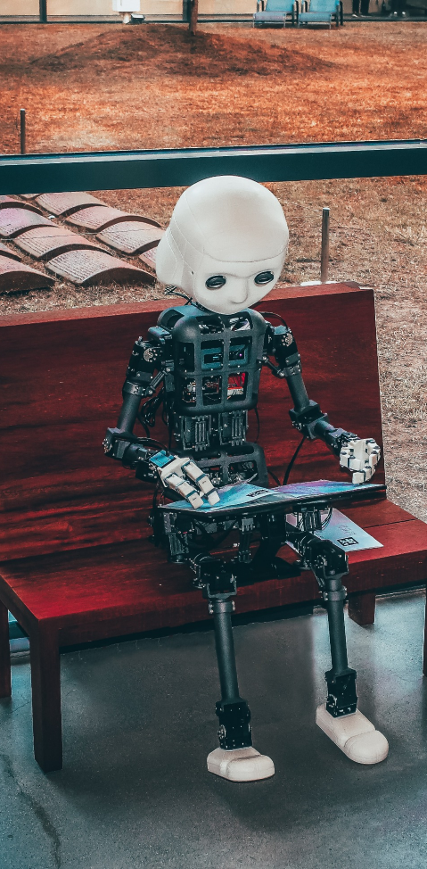
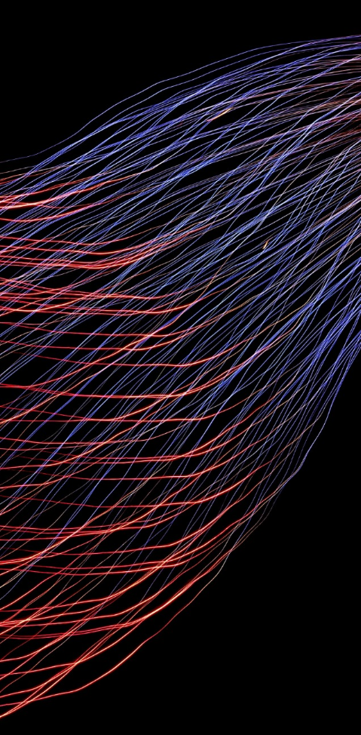
Conclusion
Introduced some basic concepts that led to our work
Discussed the most recent architecture in DT-VANET
Done with an analysis and found some of the weaknesses
Presented the solutions to those weaknesses
Successfully eliminated the issues we have identified

Slide 19




Thank You
Credit | Image: Unsplash
.

